Slide 1
String in Java
String is a sequence of characters. But in Java, a string is an object that represents a sequence of characters. The java.lang.String class is used to create string object.
Strings are immutable. By immutable, we mean that Strings are constant, their values cannot be changed after they are created. Because String objects are immutable, they can be shared.
For example: String str =”abc”; is equivalent to:
char data[] = {‘a’, ‘b’, ‘c’}; String str = new String(data);
There are two ways to create a String object:
By string literal
By new keyword

Slide 2
By string literal :
Java String literal is created by using double quotes.
For Example: String s=“Welcome”;
Each time you create a string literal, the JVM checks the "string constant pool" first. If the string already exists in the pool, a reference to the pooled instance is returned. If the string doesn't exist in the pool, a new string instance is created and placed in the pool. For example:
String s1="Welcome";
String s2="Welcome";//It doesn't create a new instance

Slide 3
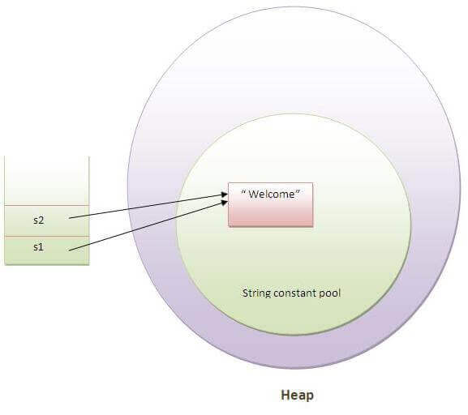
String Constant Pool

Slide 4
By new keyword :
Java String is created by using a keyword “new”.
For example: String s=new String(“Welcome”); It creates two objects (in String pool and in heap) and one reference variable where the variable ‘s’ will refer to the object in the heap.

Slide 5
For Comparing String
There are three ways to compare string in java :
By equals() method
By = = operator
By compareTo() method
1) String compare by equals() method : The String equals() method compares the original content of the string.
2) String compare by == operator : The = = operator checks ,if both objects points to the same memory location.
(The = = operator compares references not values)
3) String compare by compareTo() method : The String compareTo() method compares values on behalf of ASCII value and returns an integer value.
Suppose s1 and s2 are two string variables. If:
s1 == s2 :0
s1 > s2 :positive value
s1 < s2 :negative value

Slide 6
String Buffer vs String Builder
What is mutable string : A string that can be modified or changed is known as mutable string. StringBuffer and StringBuilder classes are used for creating mutable string.

Slide 7
